Slide 1


Applications of Machine Learning Techniques to Understand Stock Behavior
University of North Carolina at Chapel Hill
STOR 565 Machine Learning
Group Stocks: Caroline Gaede, Audrey Bristol, Jack Oglesby, Elvis Atitsoabui

Slide 2
Motivation
University of North Carolina at Chapel Hill
STOR 565 Machine Learning
Can we predict stock price using machine learning techniques?
How strong can we make the accuracy of these predictions?
Can we leverage these techniques to better predict - and therefore optimize - future return on stock prices?
Currently seen in this area of research: Boosting, Regression Trees, Support Vector Machines (SVM), Bagging
Notes:
elvis

Slide 3
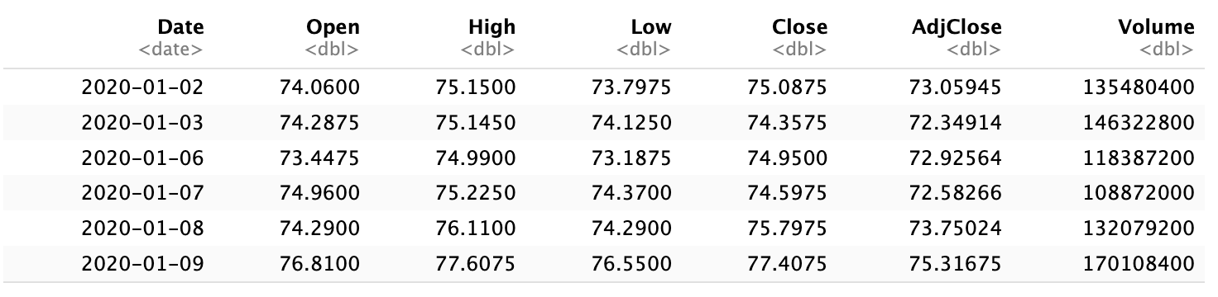
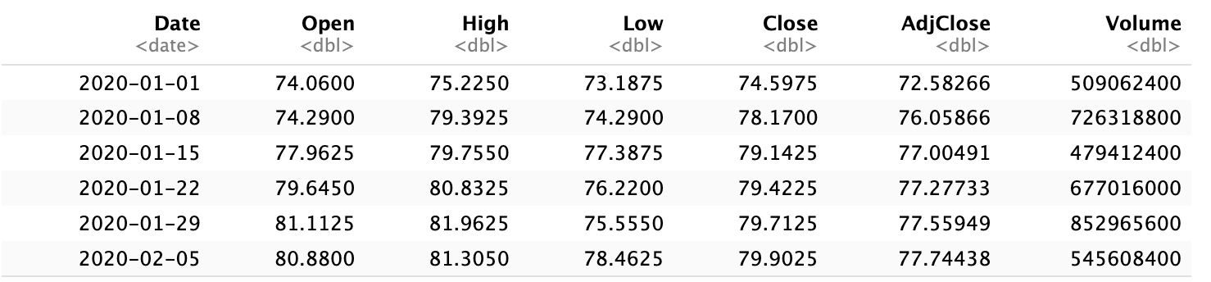
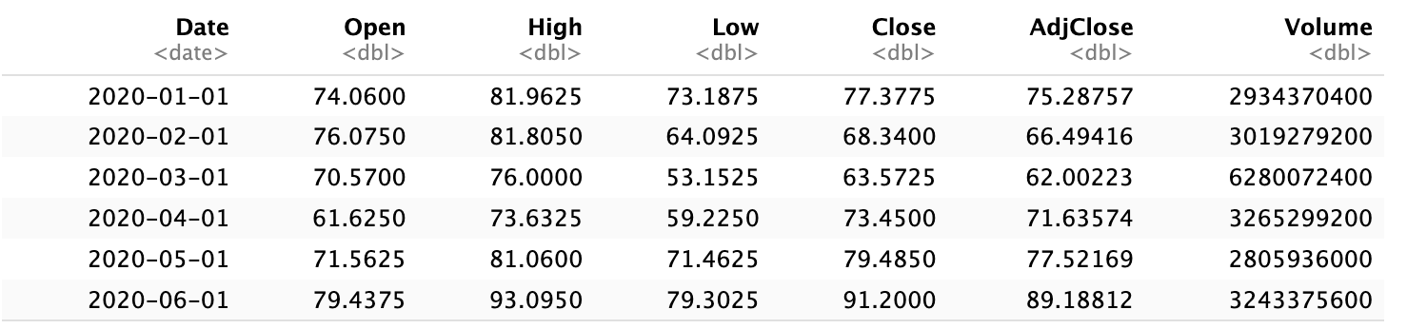
Introduction to the Dataset
University of North Carolina at Chapel Hill
STOR 565 Machine Learning
Daily
Weekly
Monthly
Notes:
AAPL stock data for daily/weekly/monthly
January 01, 2020 - December 31, 2023: 4 complete years of data
Collected from Yahoo finance
elvis

Slide 4
Introduction to the Dataset
University of North Carolina at Chapel Hill
STOR 565 Machine Learning
Returns
Daily
Weekly
Monthly
Notes:
AAPL stock data for daily/weekly/monthly
January 01, 2020 - December 31, 2023: 4 complete years of data
elvis

Slide 5
Exploratory Data Analysis: Goals
University of North Carolina at Chapel Hill
STOR 565 Machine Learning
Gather summary statistics
Observe pairwise plots and correlations
Investigate multicollinearity
Calculate and visualize Return distribution
Observe distribution of variable differences
Notes:
caroline

Slide 6
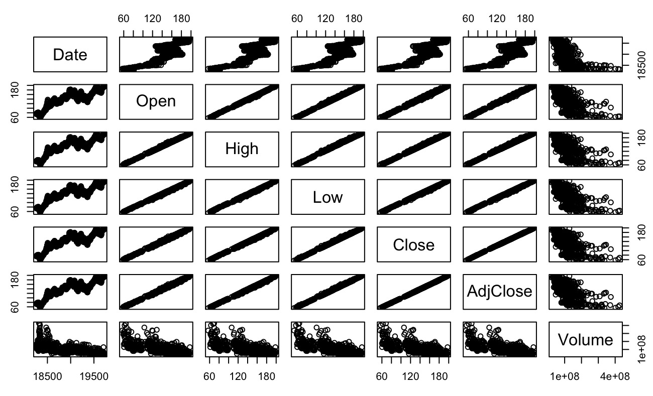
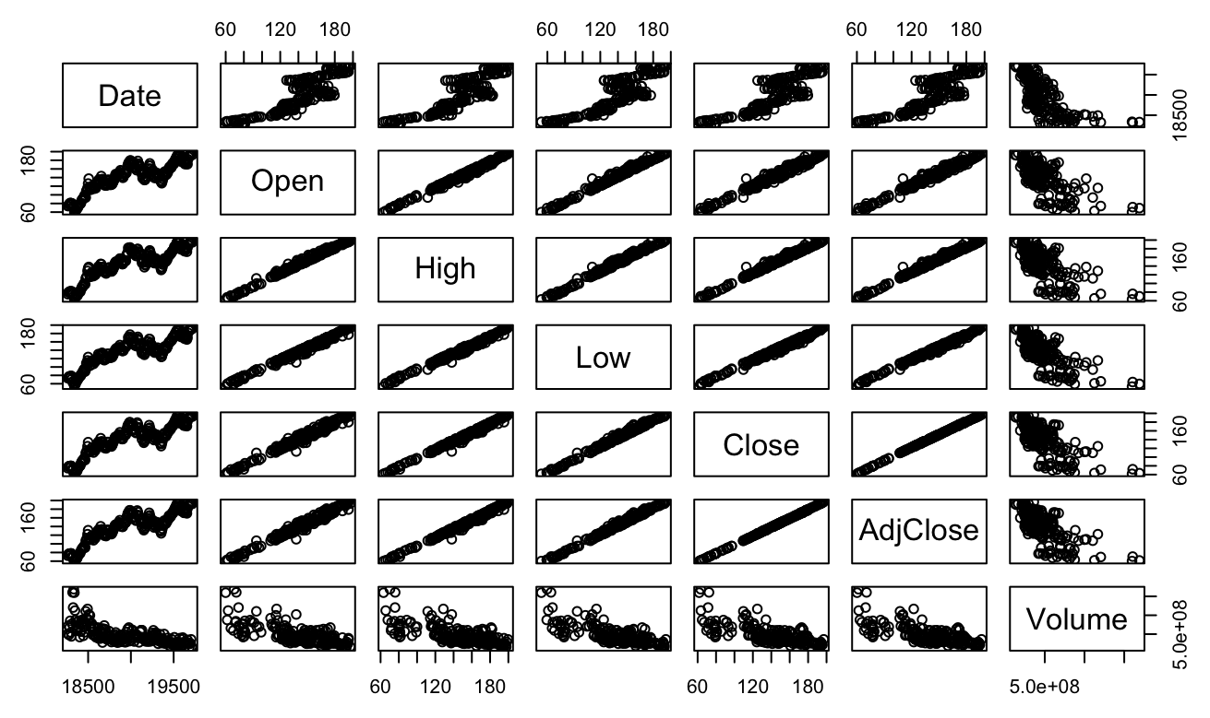
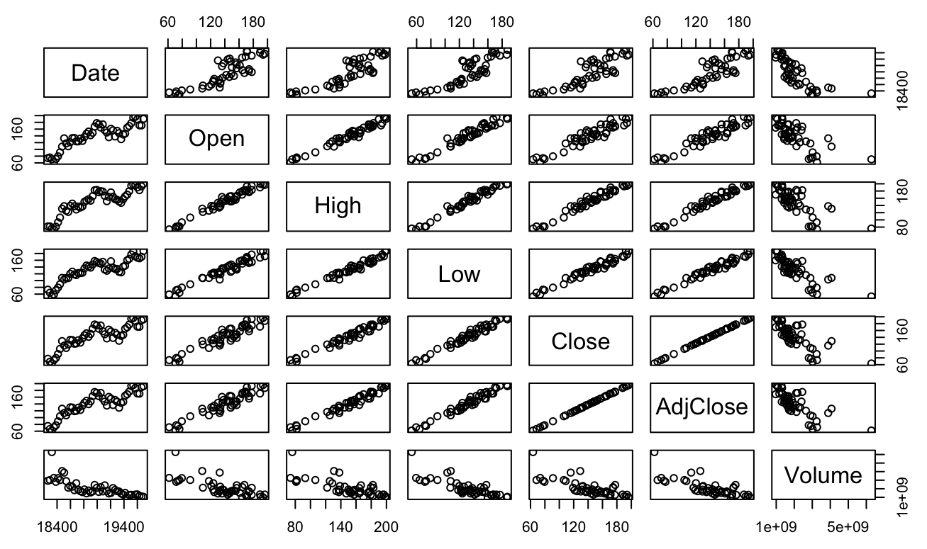
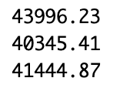
Exploratory Data Analysis: Findings
University of North Carolina at Chapel Hill
STOR 565 Machine Learning
Notes:
Caroline
Summary stats - self explanatory
Three pairwise plots (Daily / Weekly / Monthly) ON SCREEN
Variability decreases as more data points are added to the set; easy to see high positive correlations between some of these variables
Multicollinearity investigation
Simple observation of correlation matrix is not enough: check proportion of variance explained by eigenvalues of variables ON SCREEN
Condition numbers ON SCREEN
These findings propose that we will need to address multicollinearity in our models and proceed with caution
Visualizing return:
Roughly Normal distributions though distribution of Monthly returns is bordermore bimodal but more Uniform
Differences in variables:
Similar results to multicollinearity findings
Mean and median are good predictors for difference terms, especially in monthly data

Slide 7
Exploratory Data Analysis: Path Forward
University of North Carolina at Chapel Hill
STOR 565 Machine Learning
I - Stochastic Modeling & Time Series Techniques
Autoregressive (AR) Models
Autoregressive Integrated Moving Average (ARIMA) Models
II - Long Short-Term Memory (LSTM) Neural Networks
III - Tree Models
Notes:
Caroline
Measuring similarity between stock values by crating autocorrelation values and these types of models look at the stock data in terms of periods
ARIMA will do the same but also incorporate the moving average and difference between stock values at prediction times; will help tell us which directions stocks move and by how much
LSTM suited for time series data and forget gates and memory cells will help it capture patterns in the data better than regular NN
Common in industry as they are robust and interpretable, also good for picking up non-linear complex relationships and have built in functions to identify feature importance in those predictions

Slide 8
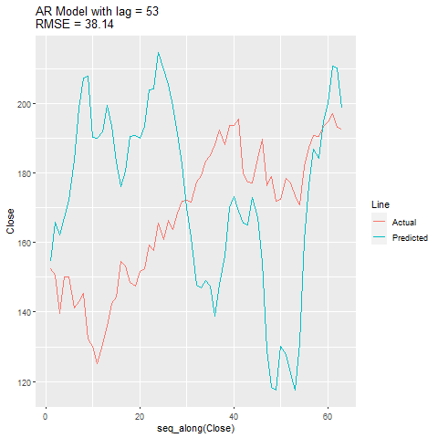
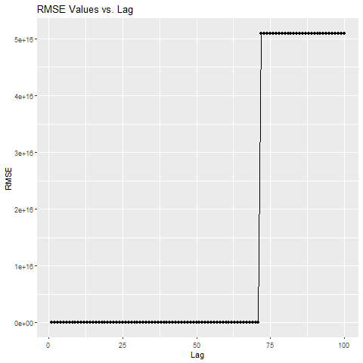
AR Model - Weekly
University of North Carolina at Chapel Hill
STOR 565 Machine Learning
Actual Return = 0.00438 Predicted Return = 0.00228
Notes:
jack
First we constructed an AR (AutoRegressive) model which is commonly used in forecasting. Essentially, it predicts future values of a time series variable based on its own past values. The “lag” term represents the number of lagged observations used to predict the current value.
We split the data into train and test data sets on a 70/30 split, then fit an AR model to the data and plotted the predictions using the model with the actual values from the test set. As you can see here for the weekly data, as the number of lag terms increased, the RMSE fluctuated and eventually spiked at 72 terms which can be attributed to overtraining. The most accurate AR model we got for the Weekly data was with a lag of 53, which gave us a predicted return of 0.002 on an actual of 0.004, with a RMSE of 38.14

Slide 9
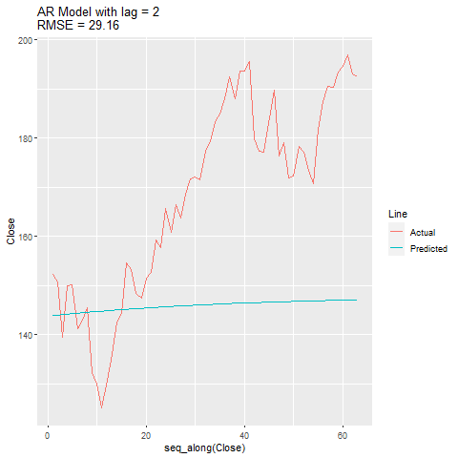
AR Model - Weekly
University of North Carolina at Chapel Hill
STOR 565 Machine Learning
Not Best RMSE Though… Predicted Return = 0.0003
Notes:
jack
However, that model did not have the best RMSE, which occurred at lag 2. The predicted return here was 0.0003. This highlights a limitation of AR modeling, which is sensitivity to order. Selecting the appropriate lag can be challenging and required some trial and error.

Slide 10
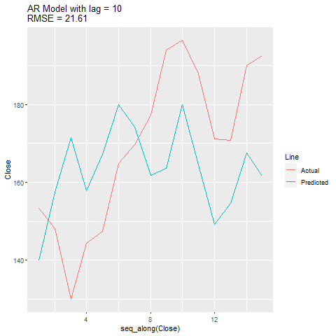
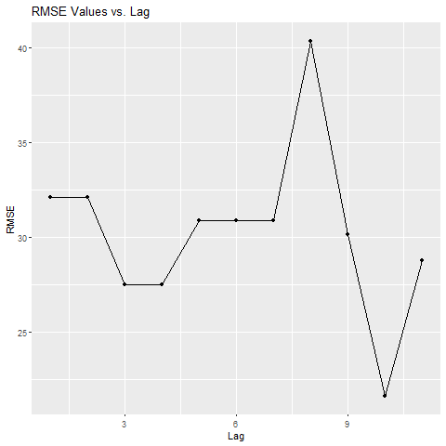
AR Model - Monthly
University of North Carolina at Chapel Hill
STOR 565 Machine Learning
Return average with Lag 10 = 0.0085( lowest RMSE, and Best Predicted Return)
Actual Return: .0189
Notes:
jack
You can see this effect with the the AR on the Monthly data. On the right the RMSE plotted for lag 1 through 11. The RMSE dips for lag 3-4, but spikes for lag 8 and then it drops even lower at lag 10 than before. On the left, you can see the actual vs. predicted lines which gave us both the lowest RMSE and best predicted return of 0.0085 on an actual of 0.0189 for Monthly.

Slide 11
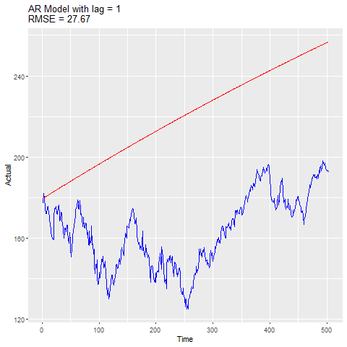
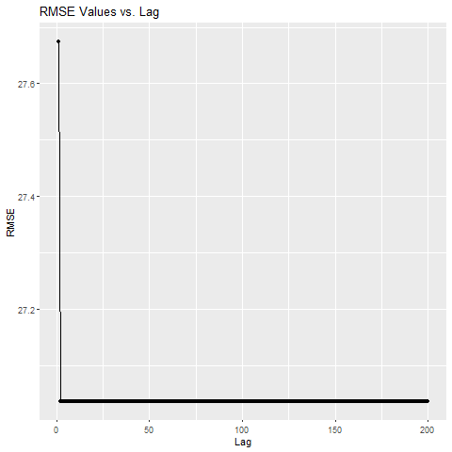
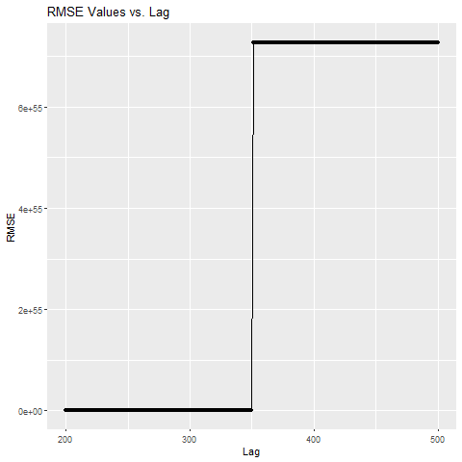
AR Model - Daily
University of North Carolina at Chapel Hill
STOR 565 Machine Learning
Actual Return = .001 Best Predicted Return = 6.48e-5(Not Accurate)
Notes:
jack
Moving to the Daily data, the AR struggled here. We thought we might have issues with the Daily data given how complex the time dependency is, and it proved true. The best predicted return we got from the Daily data was 0.00006, basically 0, and the actual was 0.001. The model overfitted and RMSE spiked after 375 lag terms. This model performed terribly on the test set.

Slide 12
Autoregressive Integrated Moving Average (ARIMA)
University of North Carolina at Chapel Hill
STOR 565 Machine Learning
Why ARIMA?
Time Series Object (Stationarity)
Check ACF Plots
Extract Returns
Errors (CV)
Create Models
auto.arima() vs. arima()
Plot
Notes:
Why ARIMA?
Ensure data is a time series object; check for stationarity with plots (look for randomness/no trends)
Check Autocorrelation (ACF) plots to check for significant autocorrelation and decay behavior (how each observation is correlated with itself when lagged)
Calculate and extract returns; univariate time series data required
auto.arima() vs. arima()
Use auto.arima() to get optimal parameters; obtain model summaries
Plot ARIMA models
Calculate and obtain accuracy measures
caroline

Slide 13
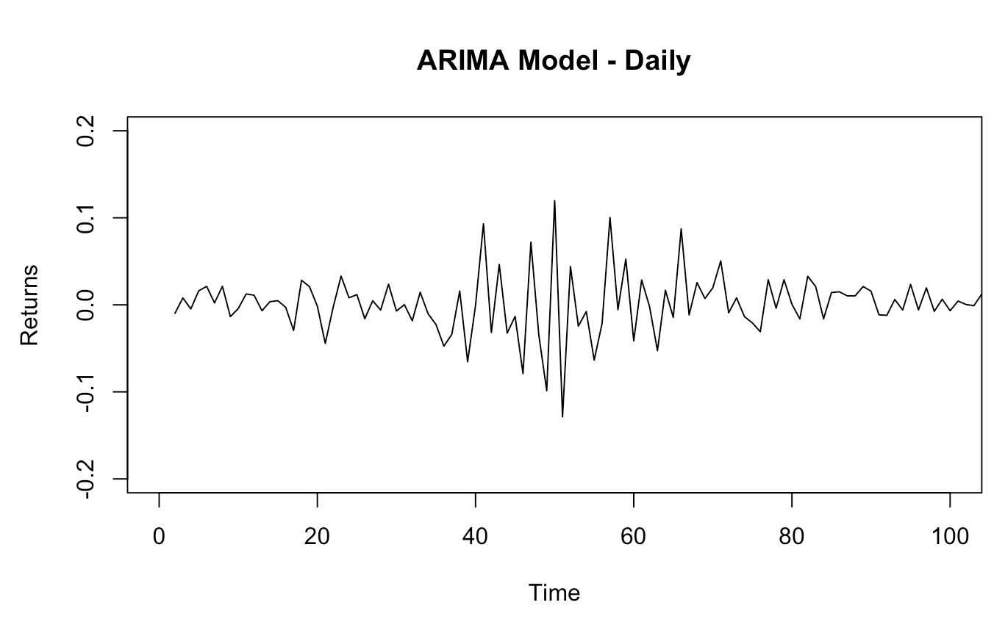
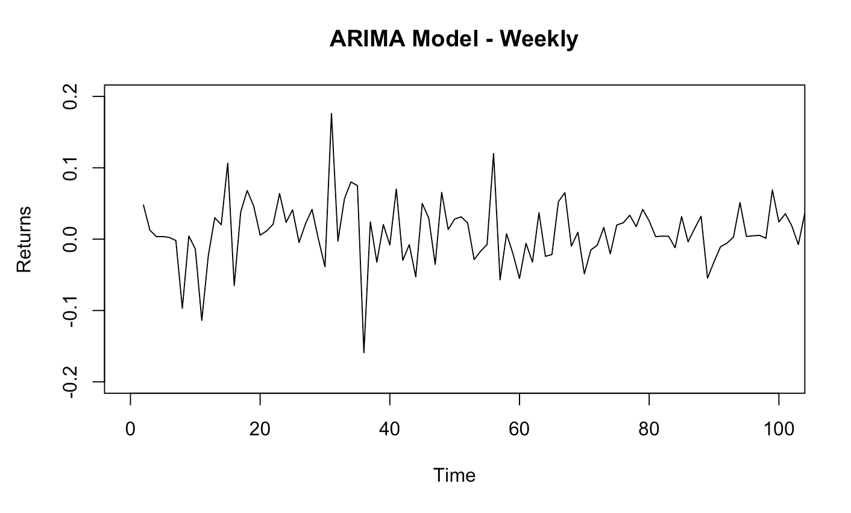
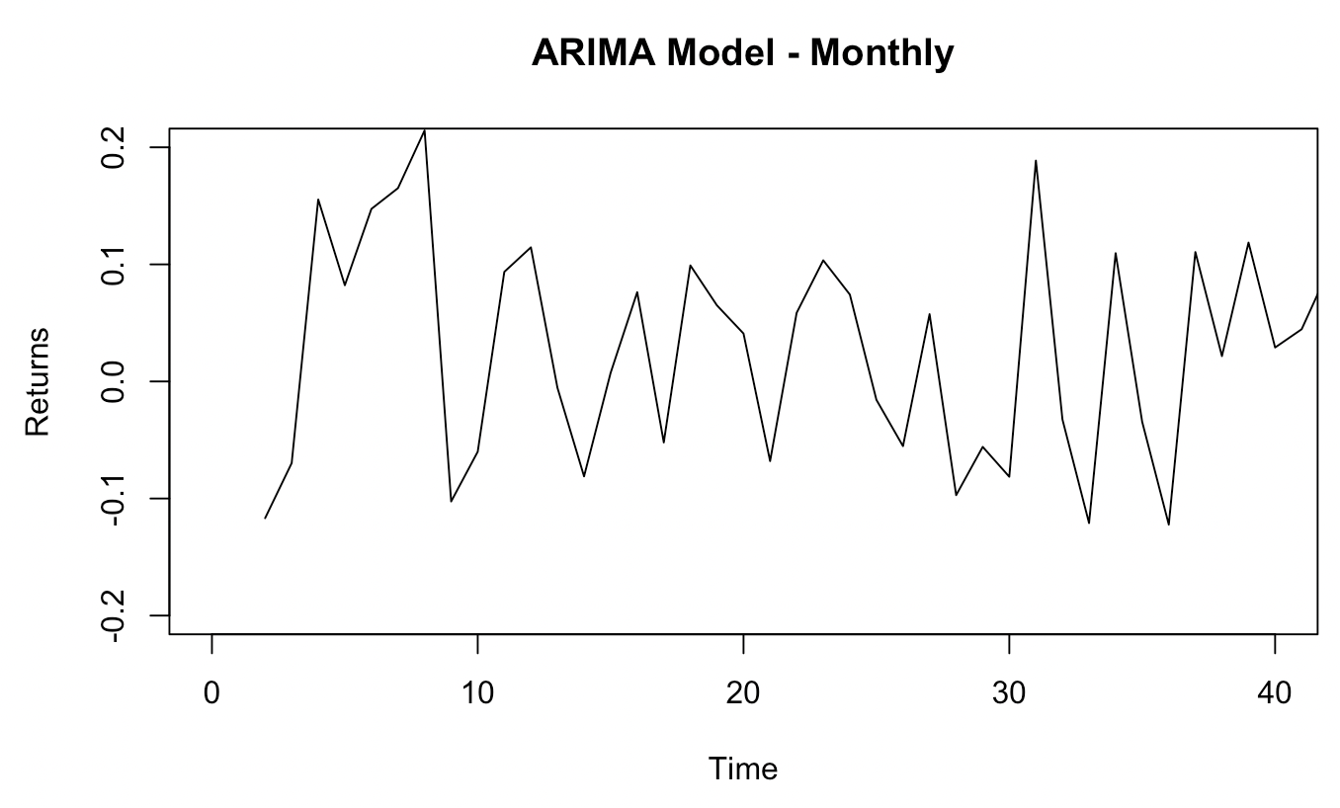
Autoregressive Integrated Moving Average (ARIMA)
University of North Carolina at Chapel Hill
STOR 565 Machine Learning
Notes:
caroline

Slide 14
Autoregressive Integrated Moving Average (ARIMA)
University of North Carolina at Chapel Hill
STOR 565 Machine Learning
 | Daily | Weekly | Monthly
MSE | 0.0004467851 | 0.001767133 | 0.008504097
MAE | 0.01495482 | 0.03129953 | 0.07893488
RMSE | 0.02113729 | 0.04203728 | 0.09221766
ME | 0.0000002140154 | -0.00000000000000645509 | -0.00000000000002929022
MAE | 0.01494558 | 0.03108545 | 0.07723515
RMSE | 0.02095271 | 0.04182298 | 0.08944994
Notes:
First table: manually calculated CV
Second table: model output from auto.arima()
Use MAE or MSE from first table
Compare MAE
caroline

Slide 15
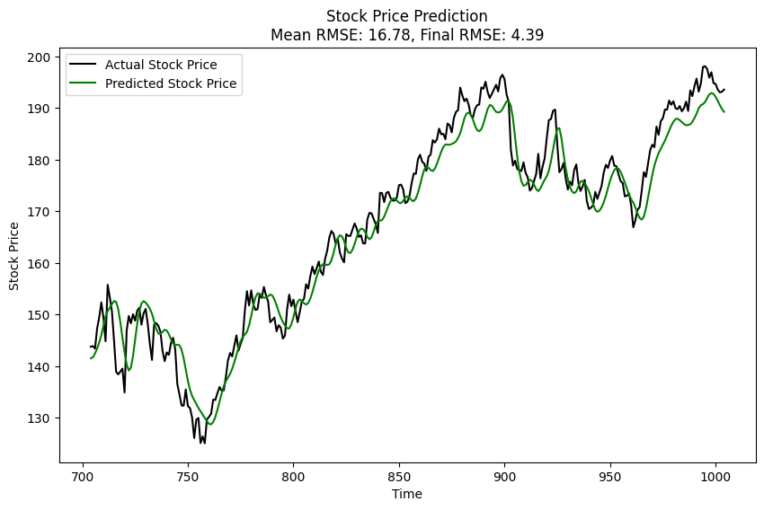
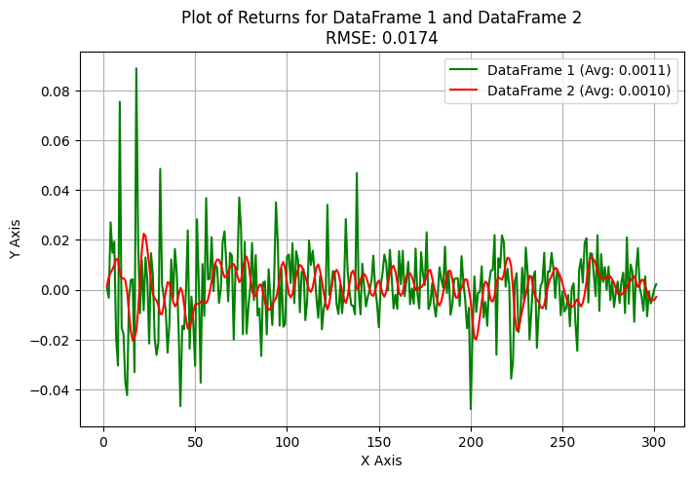
Long Short-Term Memory (LSTM) - Daily
University of North Carolina at Chapel Hill
STOR 565 Machine Learning
Notes:
elvis

Slide 16
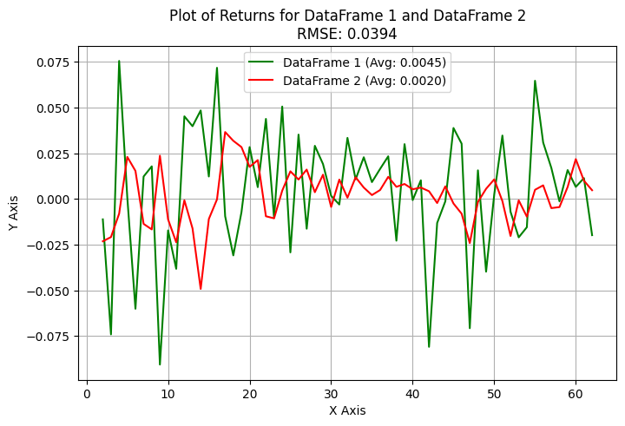
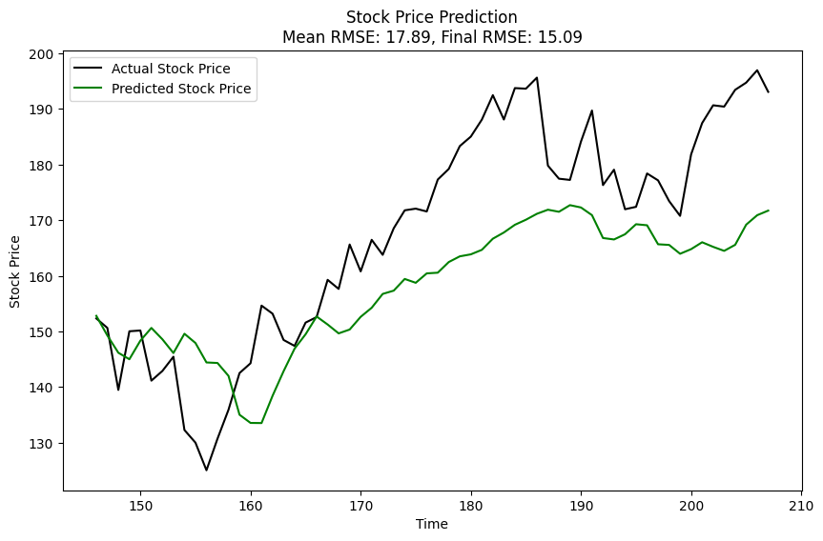
Long Short-Term Memory (LSTM) - Weekly
University of North Carolina at Chapel Hill
STOR 565 Machine Learning
Notes:
elvis

Slide 17
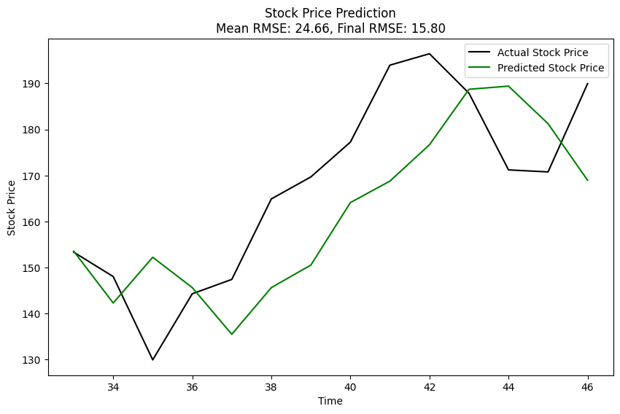
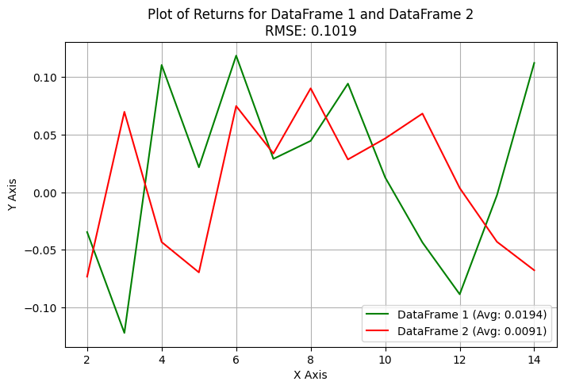
Long Short-Term Memory (LSTM) - Monthly
University of North Carolina at Chapel Hill
STOR 565 Machine Learning
Notes:
elvis

Slide 18
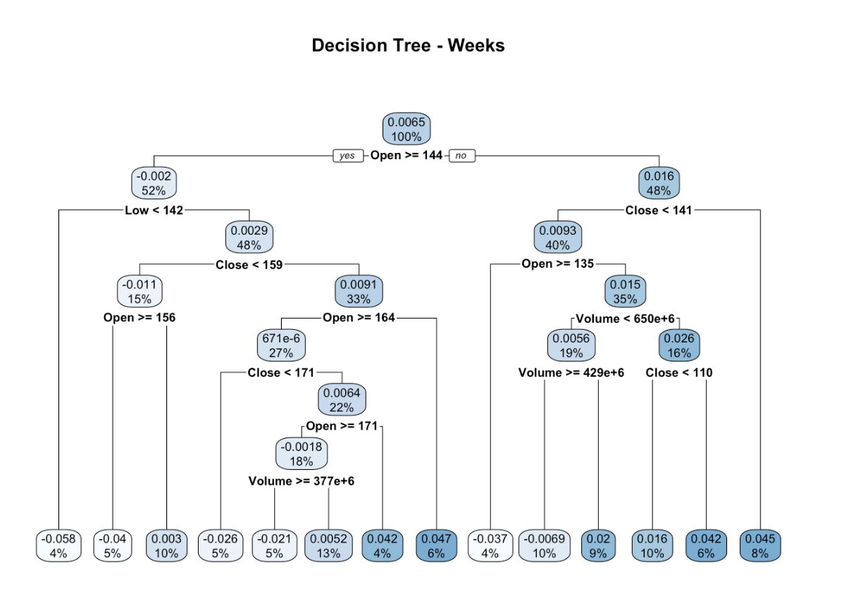
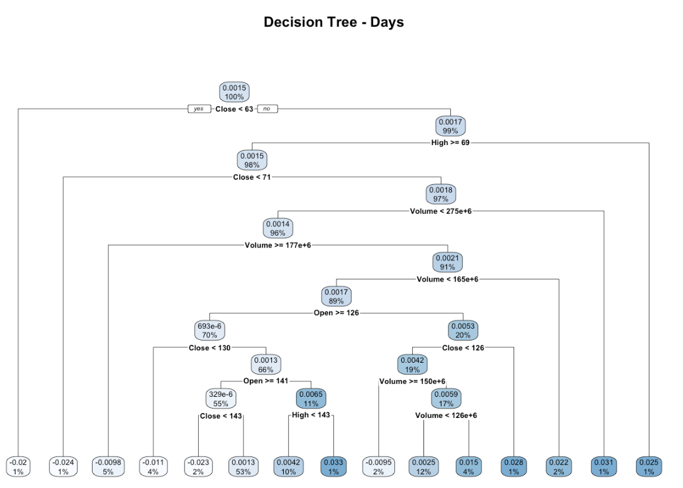
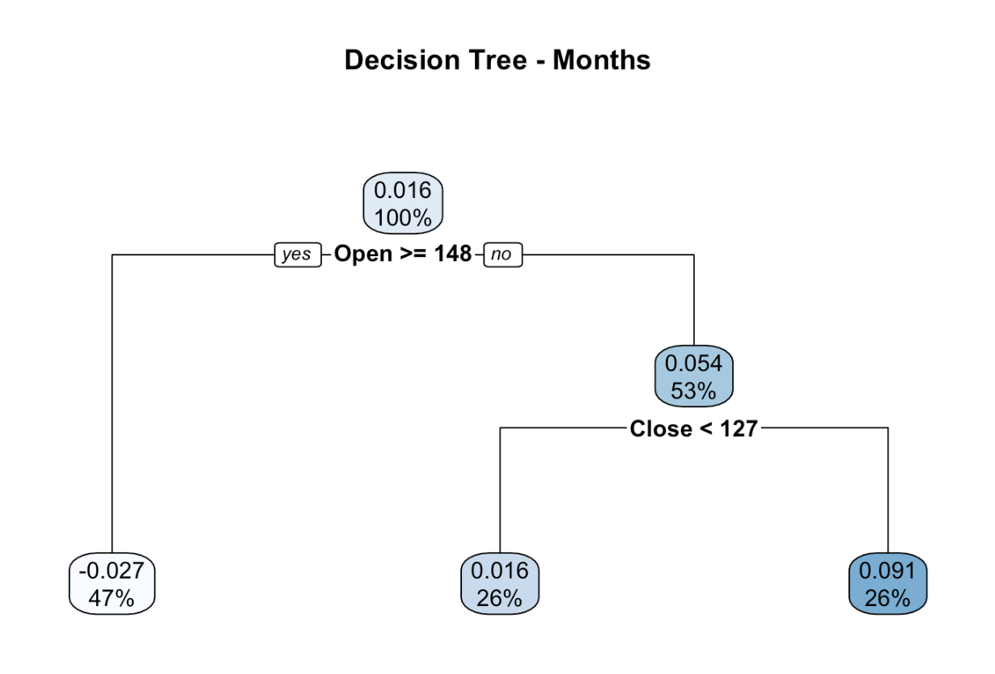
Tree Models
University of North Carolina at Chapel Hill
STOR 565 Machine Learning
SLIDE 1

Slide 19
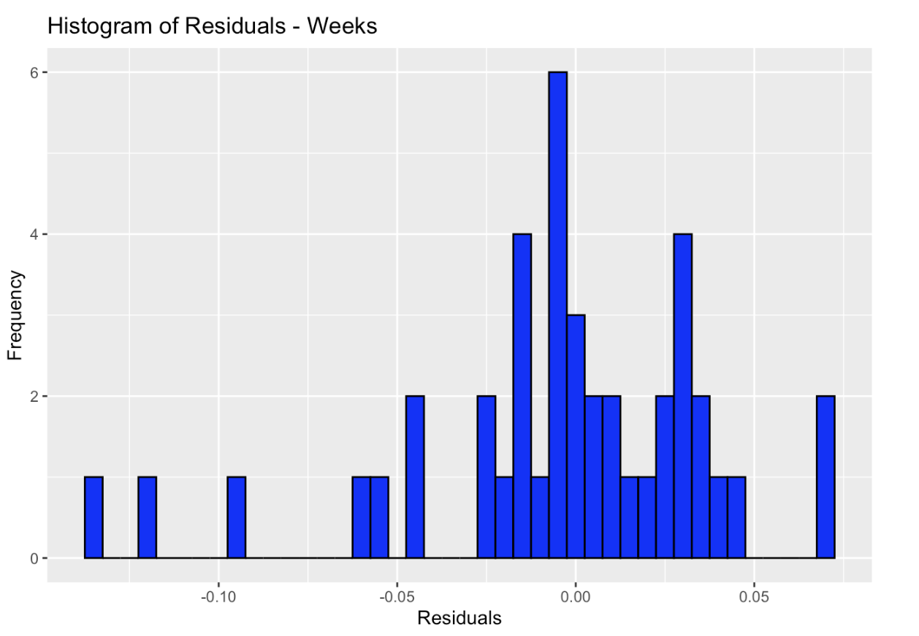
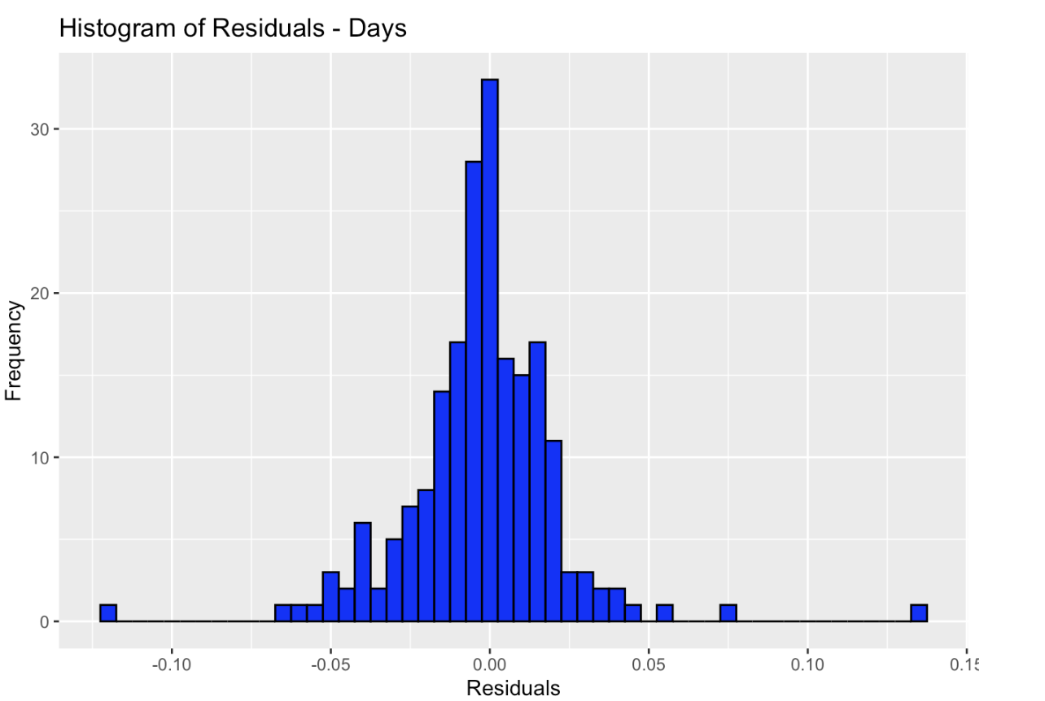
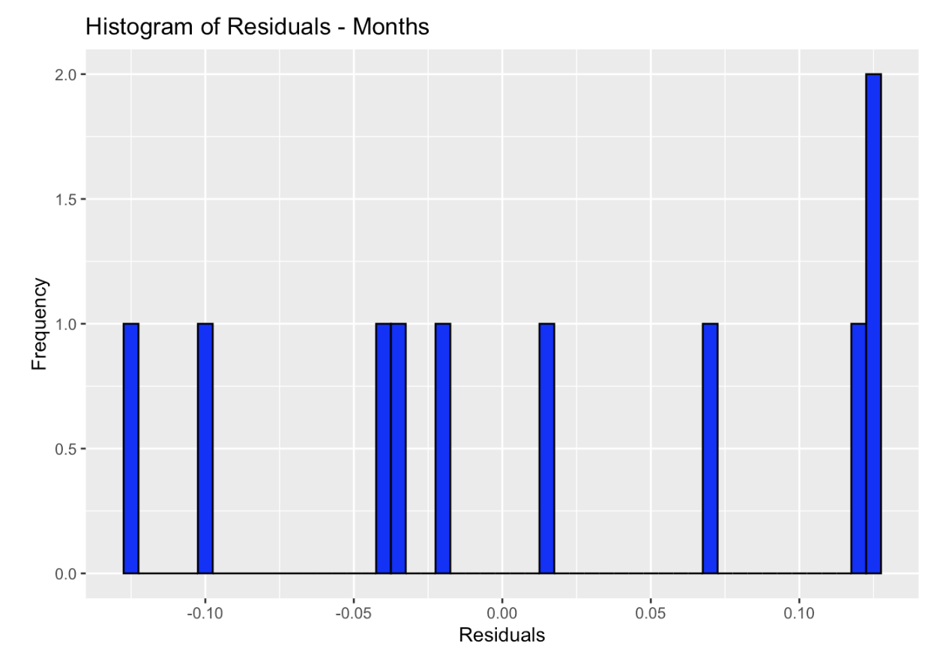
Tree Models
University of North Carolina at Chapel Hill
STOR 565 Machine Learning
SLIDE 2

Slide 20
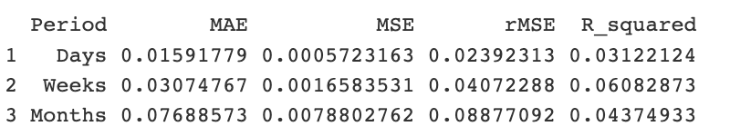
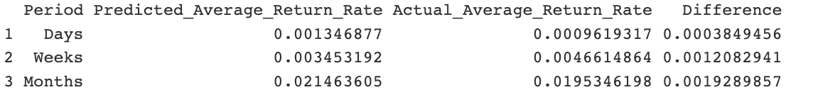
Tree Models
University of North Carolina at Chapel Hill
STOR 565 Machine Learning
SLIDE 2

Slide 21
Summary
University of North Carolina at Chapel Hill
STOR 565 Machine Learning
 | Daily RMSE | Weekly RMSE | Monthly RMSE
AR Model | .0165 | .0633 | .1028
ARIMA Model | 0.0211 | 0.0420 | 0.0922
LSTM Model | 0.0174 | 0.0394 | 0.1019
Tree Model | 0.0239 | 0.0407 | 0.0888
Notes:
audrey

Slide 22
Questions?
University of North Carolina at Chapel Hill
STOR 565 Machine Learning

